Slide 1

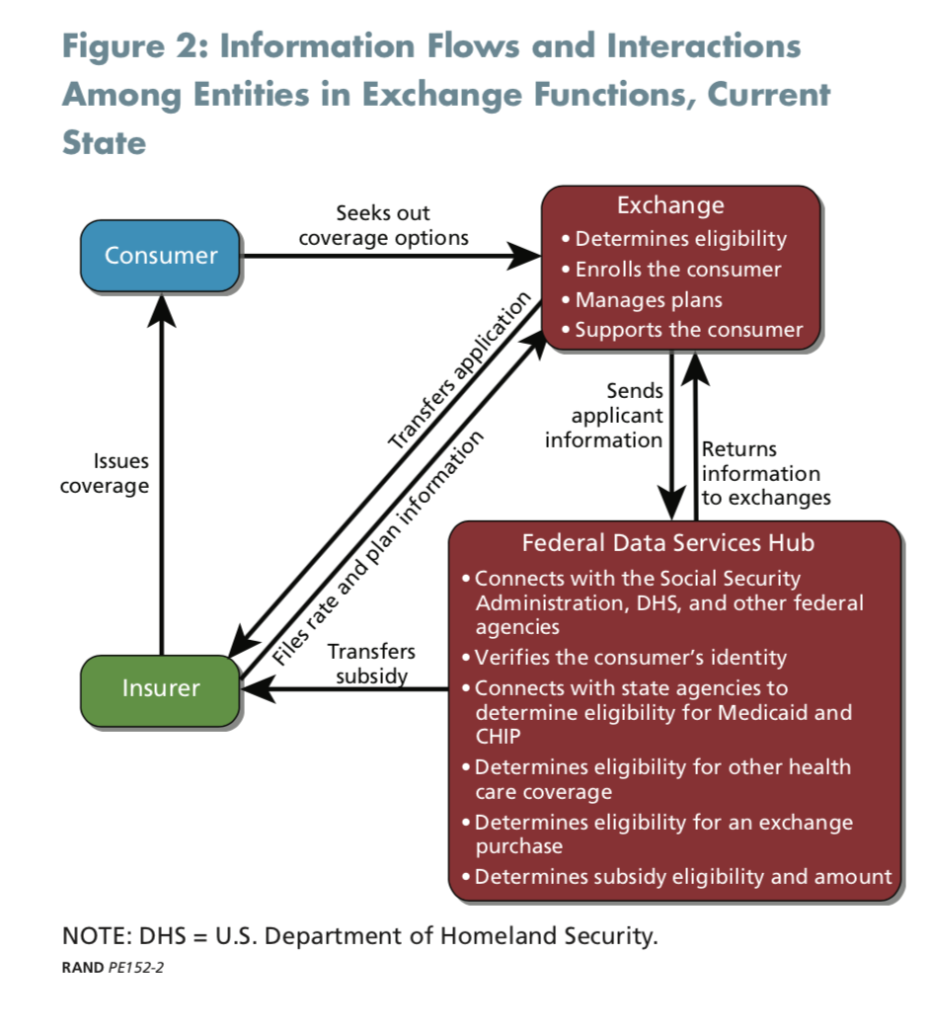
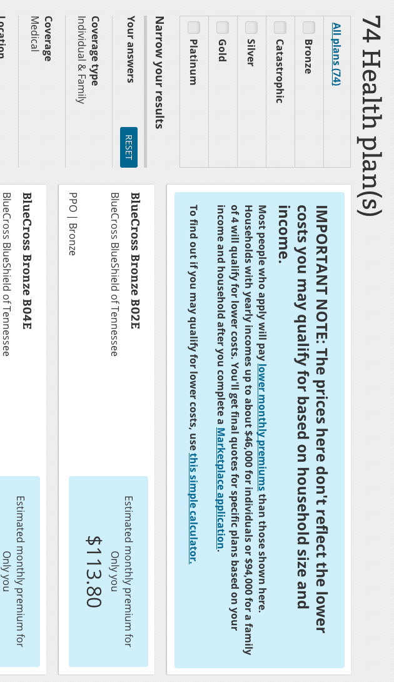
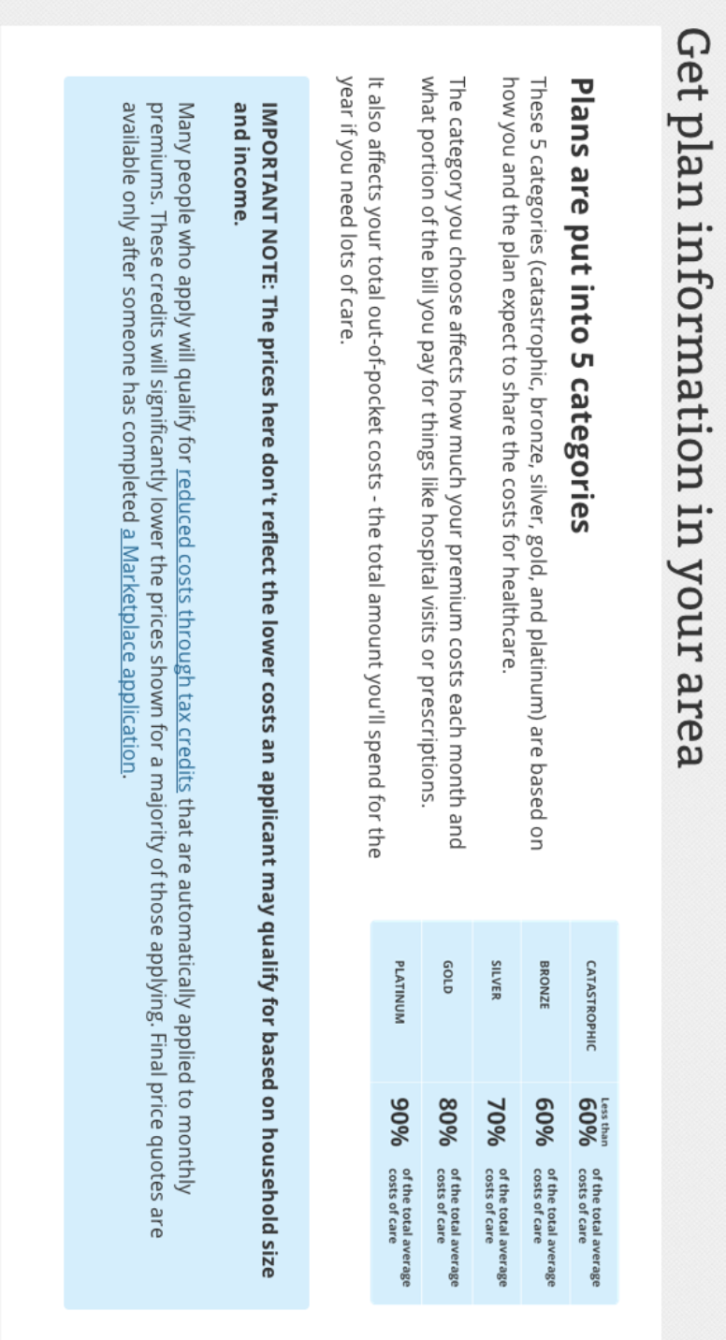

Positions
No Transparency, health insurance plance are a black box
Government makes health insurance information available publicly
Individual comp anies are responsible for making inform ation available on perso nal websites
Introduction
Coverage varies by state, income level, and age
Every state has its own “marketplace” website
Lack of ease of use is a reason individuals do not enroll in health insurance
Research Question
Should health insurance information be made easily accessible through online platforms?
Figure 1: Screenshot of Healthcare.gov
Information Asymmetry in Online Healthcare Insurance Marketplace
Figure 2: Information Flows and Interactions among Entities in Exchange Functions (RAND)
Vasilisa Gorbolskaya Kevin Bender
vgorbols@andrew.cmu.edu kbender1@andrew.cmu.edu
Findings
Private health insurance is currently one-sided favoring insurers who are not transparent
Both the government and insurers share a responsibility to ensure customers are well-informed and receive affordable healthcare
Works Cited
“Health Insurance Individual Marketplace Guide.” Direct Care for Us - Direct Primary Care, 2 Jan. 2017, directcareforus.com/health-insurance/.
Gresenz, et al. “Harnessing Private-Sector Innovation to Improve Health Insurance Exchanges.” RAND Corporation, 6 Nov. 2015, www.rand.org/pubs/perspectives/PE152.html.
Figure 3: Screenshot of Healthcare.gov
Notes:
74 health plan: Screenshot of current Healthcare.gov
Shows that the market place is a
Figure 2: Information Flows and Interactions among Entities in Exchange Functions (RAND)
figure 2: Screenshot of current Healthcare.gov

